Slide 1
Week 13: Psychiatric Pharmacology
Prof. Nancy Nurse

Slide 2
Learning Objectives
Antidepressant drug classes:
Compare SSRIs, SNRIs, TCAs, MAOIs, and atypicals by mechanism and clinical selection
Recognize serotonin syndrome and discontinuation syndrome
Anxiety, bipolar, and psychotic disorders:
Select and monitor pharmacotherapy for anxiety, bipolar disorder, and psychosis
Compare first- and second-generation antipsychotics; understand clozapine monitoring
Special populations and conditions:
Prescribe appropriately for ADHD and insomnia; apply Beers Criteria to older adults
Apply core psychiatric prescribing principles including trial duration and safety monitoring

Slide 3
Psychiatric Prescribing: What's Different
Why psychiatric drugs require a different mindset:
Therapeutic effects are delayed — weeks, not hours
Side effects appear before benefits — patients stop too soon
Patients often can't tell you whether they're better (insight is impaired)
The four commandments:
Adequate dose — underdosing is rampant in primary care
Adequate duration — minimum 4–6 weeks at therapeutic dose before calling it a failure
Augmentation vs. switching — know the difference and when to do each
Document shared decision-making — always discuss risks, including black box warnings

Slide 4
Black Box Warnings in Context: Suicidality
FDA black box warning — antidepressants and suicidal ideation:
Applies to patients under age 25 during the first weeks of treatment
Based on pooled RCT data — increased suicidal thinking, not completed suicides
Risk highest in the first 1–4 weeks; monitor closely
The clinical context that matters:
Untreated depression carries far greater risk of suicide than treated depression
Over age 65: antidepressants actually reduce suicidal ideation
Black box warning is NOT a reason to withhold treatment — it is a reason to monitor
Practical action:
See patient within 1–2 weeks of initiating treatment
Provide 24-hour crisis resources at every visit
Prescribe limited quantities initially in high-risk patients

Slide 5
Depression: The Monoamine Framework
The monoamine hypothesis (simplified):
Depression is associated with reduced serotonin, norepinephrine, and/or dopamine activity
All antidepressants ultimately increase monoaminergic neurotransmission
Why effects are delayed:
Receptor occupation happens within hours of the first dose
Clinical effect requires downstream neuroplasticity — BDNF upregulation, receptor remodeling
This takes 2–6 weeks — and sometimes longer in older adults
The model's limits:
Ketamine works via NMDA receptor antagonism — rapid response within hours
Monoamine depletion alone does not reliably cause depression in healthy individuals
The hypothesis explains our drugs better than it explains the disease

Slide 6
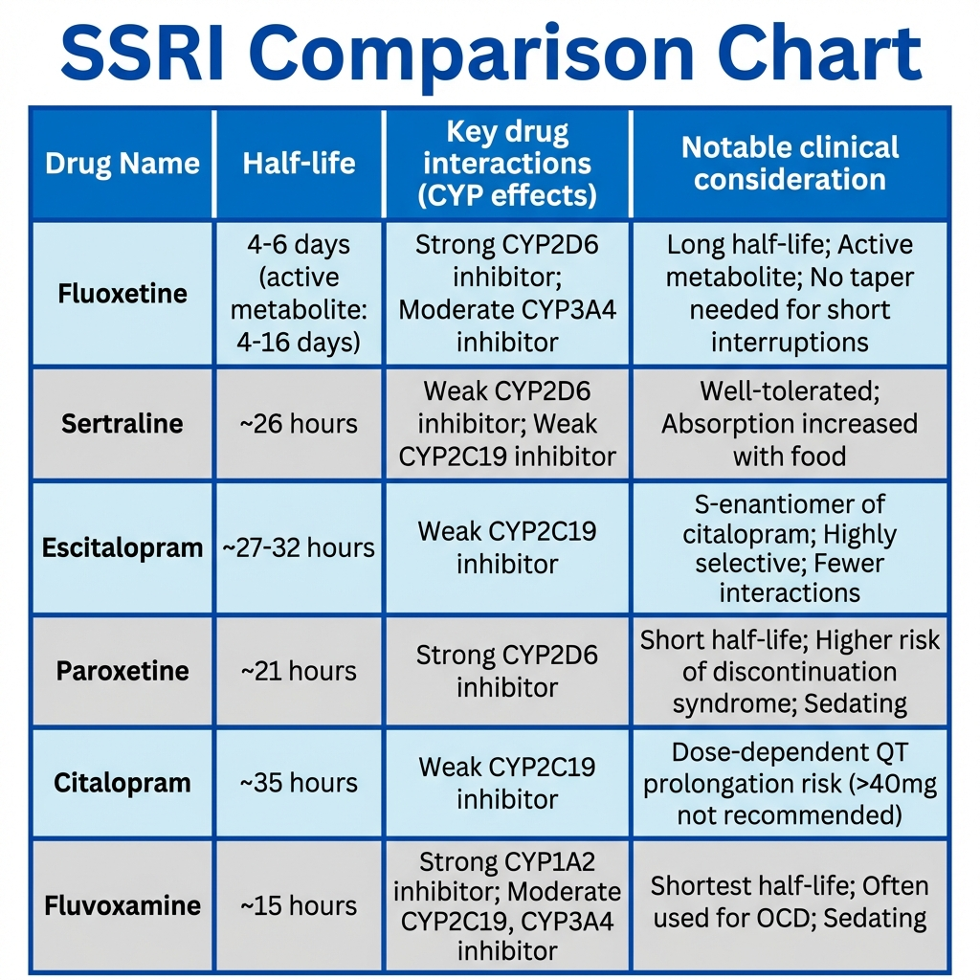
SSRIs: First-Line for Depression and Anxiety
Mechanism:
Block serotonin transporter (SERT) → increased synaptic serotonin
No significant effect on norepinephrine or dopamine transporters (at usual doses)
First-line for:
Major depressive disorder, generalized anxiety disorder, PTSD, OCD, panic disorder, social anxiety
Key differences among SSRIs:
Fluoxetine — longest half-life (1–4 days); active metabolite; least discontinuation syndrome risk; most CYP2D6 inhibition
Sertraline — preferred in cardiac patients; few drug interactions; once daily
Escitalopram — most selective SSRI; fewest drug interactions; good tolerability
Paroxetine — shortest half-life; highest anticholinergic burden; most discontinuation syndrome risk; avoid in pregnancy
Citalopram — dose-dependent QTc prolongation; max 40 mg/day (20 mg/day in elderly or CYP2C19 poor metabolizers)
Fluvoxamine — used primarily for OCD; strong CYP1A2 and CYP3A4 inhibitor

Slide 7
SSRI Common Side Effects: What to Tell Every Patient
Expect these — they often improve:
GI: nausea, diarrhea — take with food; usually resolves in 1–2 weeks
Headache — common in first 2 weeks
Insomnia or somnolence — dose timing adjustment may help
Expect these — they may not improve:
Sexual dysfunction: decreased libido, delayed orgasm, anorgasmia — affects 30–40% of patients
Weight gain — more pronounced with paroxetine
Rare but serious:
Hyponatremia (SIADH) — especially in elderly patients; monitor sodium
Bleeding risk — SSRIs reduce platelet serotonin; additive with NSAIDs/anticoagulants
Serotonin syndrome — see next slide

Slide 8
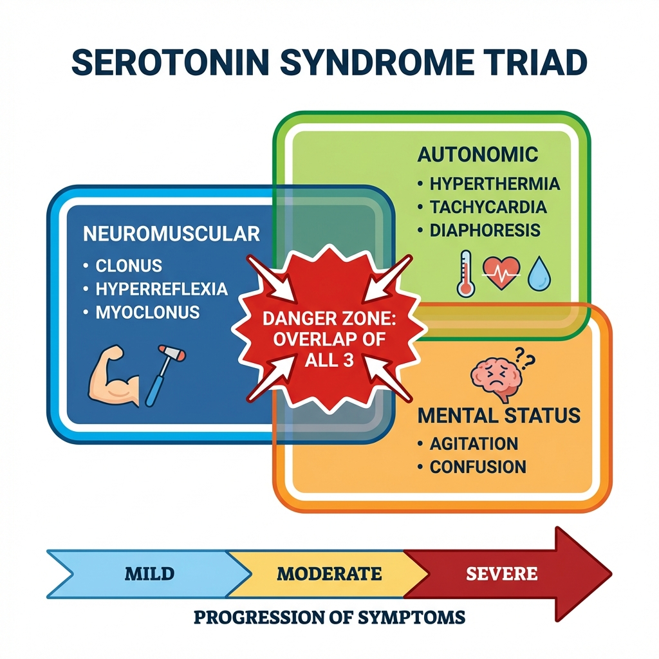
Serotonin Syndrome: Recognize It Fast
What it is:
Excess serotonergic activity at central and peripheral receptors
Caused by drug combinations, overdose, or drug-drug interactions
Classic triad:
Neuromuscular abnormalities: clonus, hyperreflexia, tremor, myoclonus
Altered mental status: agitation, confusion, restlessness
Autonomic instability: hyperthermia, tachycardia, diaphoresis, hypertension
High-risk combinations:
SSRI + MAOI — never combine; washout period required
SSRI + tramadol — tramadol has serotonergic activity
SSRI + linezolid — linezolid is a weak MAOI
SSRI + triptans — low risk in therapeutic doses, but monitor
SSRI + St. John's Wort — serotonin excess; ask about supplements
Management:
Discontinue offending agents; supportive care; cyproheptadine for serotonin antagonism

Slide 9
Discontinuation Syndrome
What happens when an SSRI is stopped abruptly:
Serotonin rebound — the transporter is suddenly unblocked
Symptoms: FINISH mnemonic
Flu-like symptoms (nausea, diarrhea, myalgias)
Insomnia, vivid dreams
Nausea
Imbalance, dizziness, 'brain zaps' (brief electric shock sensation)
Sensory disturbances
Hyperarousal, anxiety, irritability
Which SSRIs carry the highest risk:
Paroxetine — highest risk (shortest half-life, no active metabolite)
Venlafaxine (SNRI) — also high risk
Fluoxetine — lowest risk (self-tapering due to long half-life)
Prevention and management:
Always taper — do not stop abruptly after more than a few weeks of therapy
Slow taper over weeks to months for long-term users

Slide 10
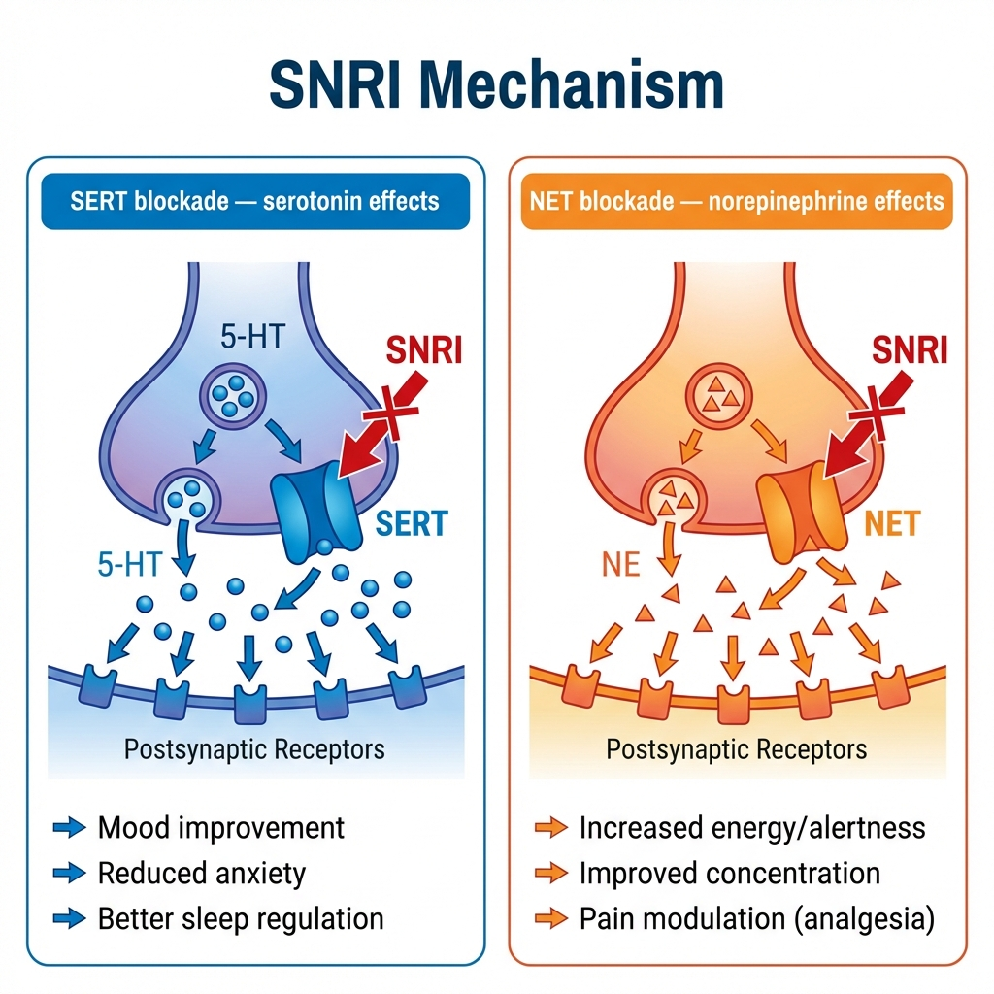
SNRIs: Serotonin + Norepinephrine
Key agents:
Venlafaxine (Effexor XR) — serotonin-selective at low doses; NE effects emerge above 150 mg/day; can raise BP at high doses
Duloxetine (Cymbalta) — FDA approved for depression, generalized anxiety, diabetic neuropathy, fibromyalgia, chronic musculoskeletal pain; avoid with significant hepatic impairment
Desvenlafaxine (Pristiq) — active metabolite of venlafaxine; predictable kinetics; fewer CYP interactions
Levomilnacipran (Fetzima) — highest NE:serotonin ratio; useful when fatigue and concentration are prominent
NE-related side effects:
Hypertension — monitor BP, especially at higher doses
Urinary hesitancy — alpha-1 agonism
Sweating, tachycardia
Clinical niche:
Depression + neuropathic pain — duloxetine is first-line
Depression + anxiety — excellent dual coverage

